Slide 1
BITS ‘N’ BYTES
RHT-099
DONE BY:
KRITHIK GOPINATH - R19CS163
TEJASWI MAYALURI - R19CS185
HRITESH J - R19CS132

Slide 2
ELLIE
SMART AND COOL AI DESKTOP BOT

Slide 3
GOAL
Walk: Ellie has 4 servos(small motors), which helps in its movement.
Dance: Given a specific code it can even move and groove to a few beats.
See: Ellie features an HD camera with face recognition that can remember you.
Hear: Ellie has microphones which can capture sounds and locate the source direction instantly. If you need him, just say “Hey Ellie!”
Communicate: Ellie’s speaker can play your favorite playlist and communicate with you with adorable simulated sounds.

Slide 4
CURRENT STATUS
Completed calibration for the robot.
Can balance on it’s legs and is able to walk.
Can detect obstacles in front of it and prevent itself from coming into contact with the obstacle.

Slide 5
COMPONENTS USED
Four SG90 servos
Arduino nano
Arduino nano programing cable.
expansion shield for arduino nano.
Ultrasonic module.
Gel based super glue.
3.7V 1000mAh battery
Screwdriver and screws.
Servo Top that comes with servo.
Female to female wire.
Male to female wires.

Slide 6
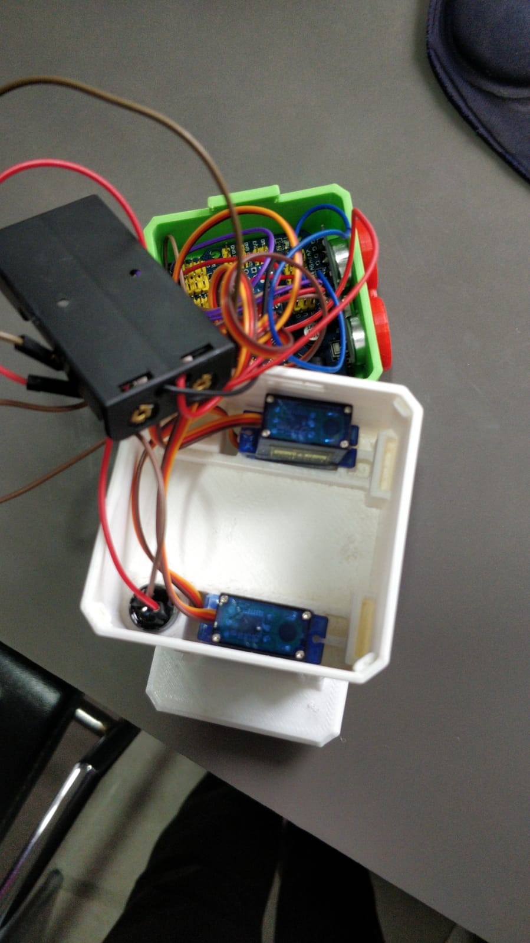
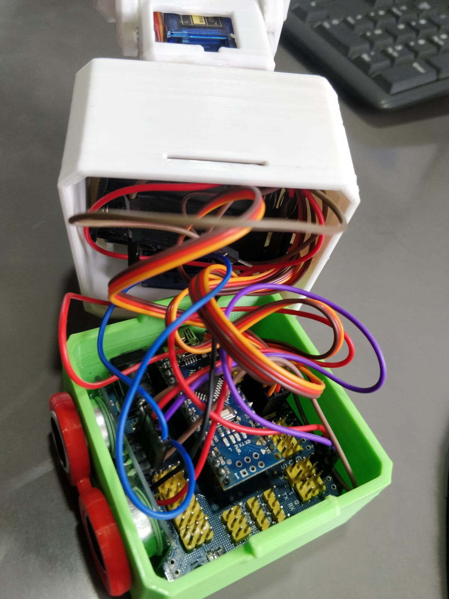
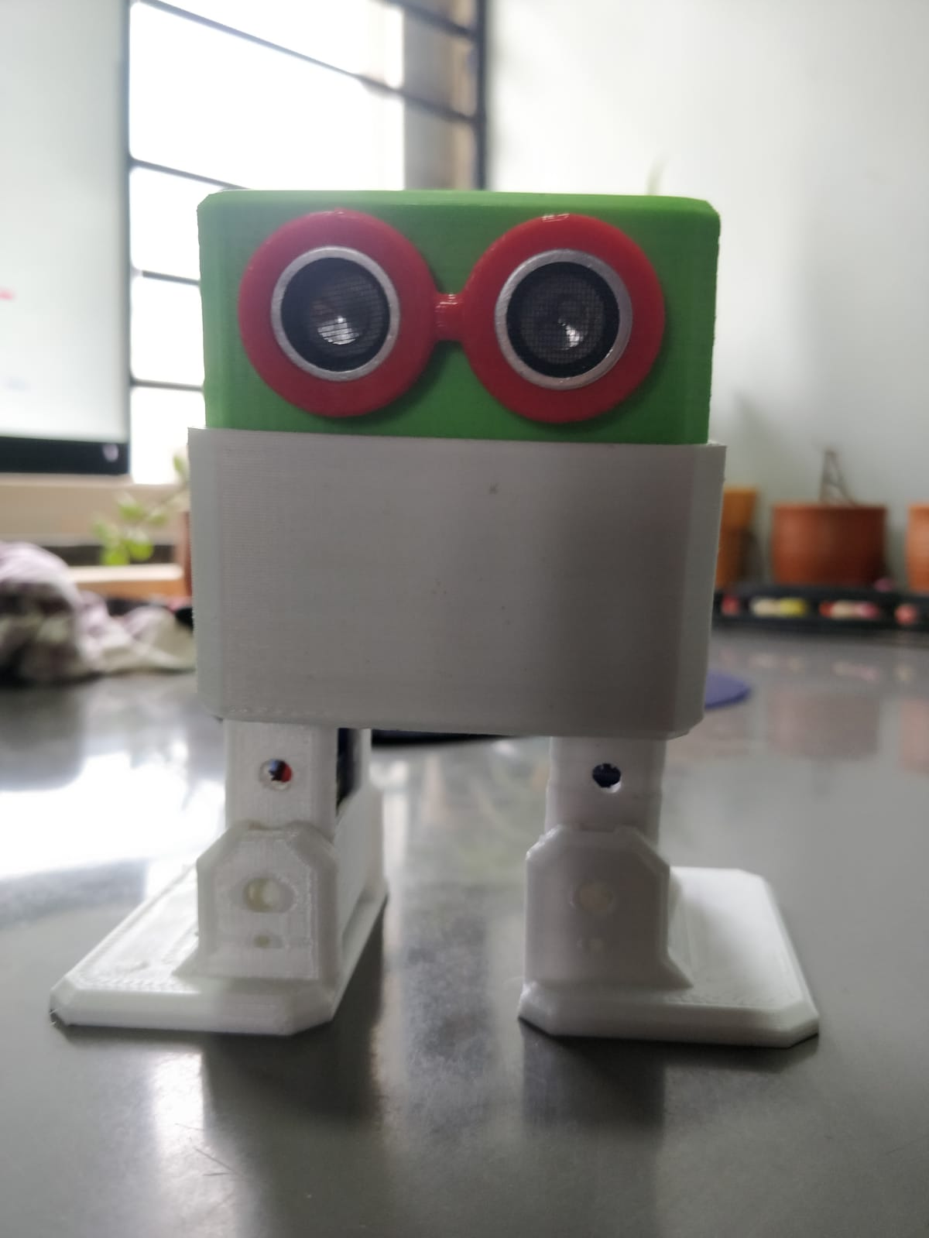
IMAGES AND VIDEOS

Slide 7
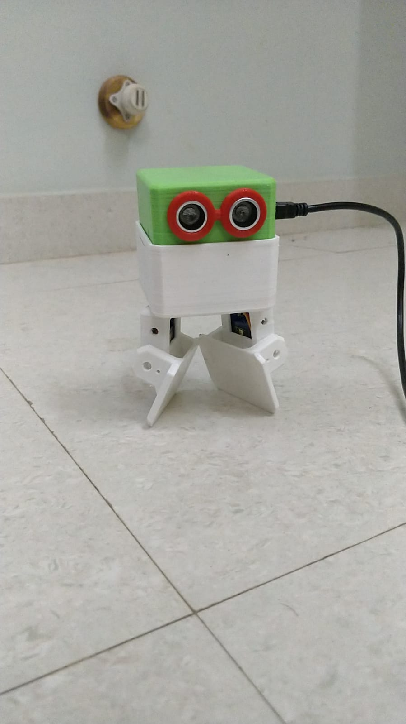
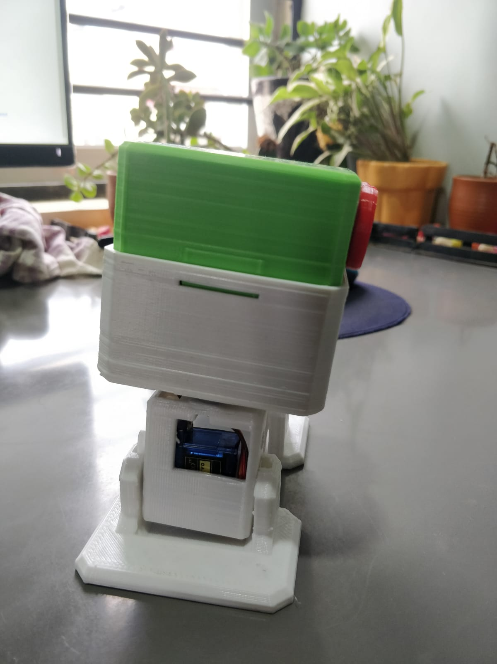
Images

Slide 8
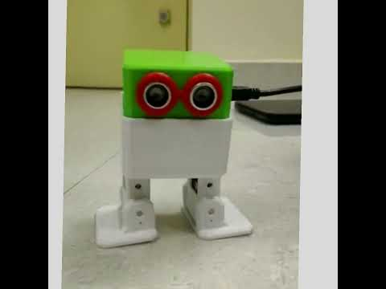
Avoid Objects
https://www.youtube.com/watch?v=ClFrHIPAnk0&list=PLwhVBibIJRdMQu2ssoMi6C2XaCQfVydRz&index=1

Slide 9
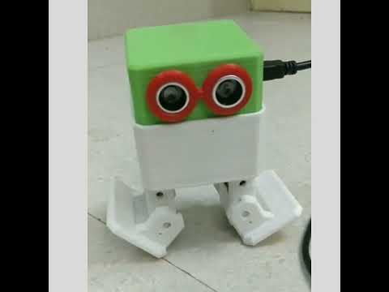
DANCE
https://www.youtube.com/watch?v=RZPnS8mp6UM&list=PLwhVBibIJRdMQu2ssoMi6C2XaCQfVydRz&index=2

Slide 10
PROBLEMS FACED
Calibrating the robot.
Faced issues while configuring the angle of the robot legs(servos).

Slide 11
SOURCE CODE
https://github.com/Krithik09/Bits-N-Bytes

Slide 12
REFERENCES
https://www.ottodiy.com/community
https://living.ai/docs/emo/

Slide 13
TEAM
KRITHIK GOPINATH -R19CS163
TEJASWI MAYALURI -R19CS185
HRITESH J - R19CS132

